Slide 1
vytality fitness
Creators:
Greg Bastien
Hung Nguyen

Slide 2
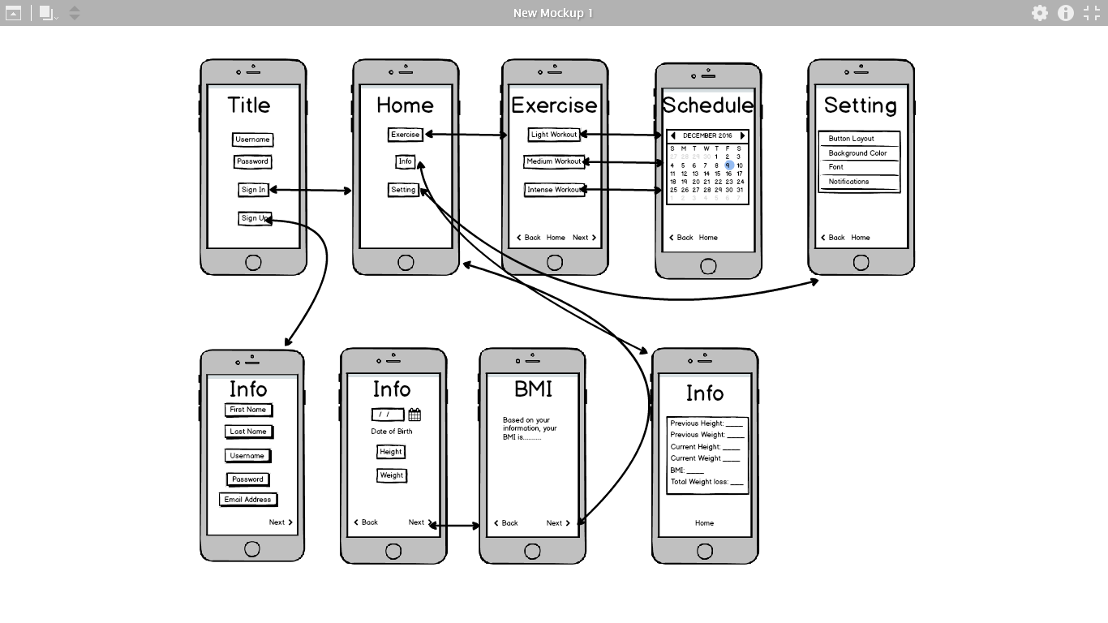
In the beginning….

Slide 3
Obesity and Heart disease
Obesity is a preventable disorder
US has the highest rate in the world
Obesity leads to heart disease such as heart failure

Slide 4
Goals
To help prevent obesity
To reduce the rate of heart diseases
To improve people’s lifestyles

Slide 5
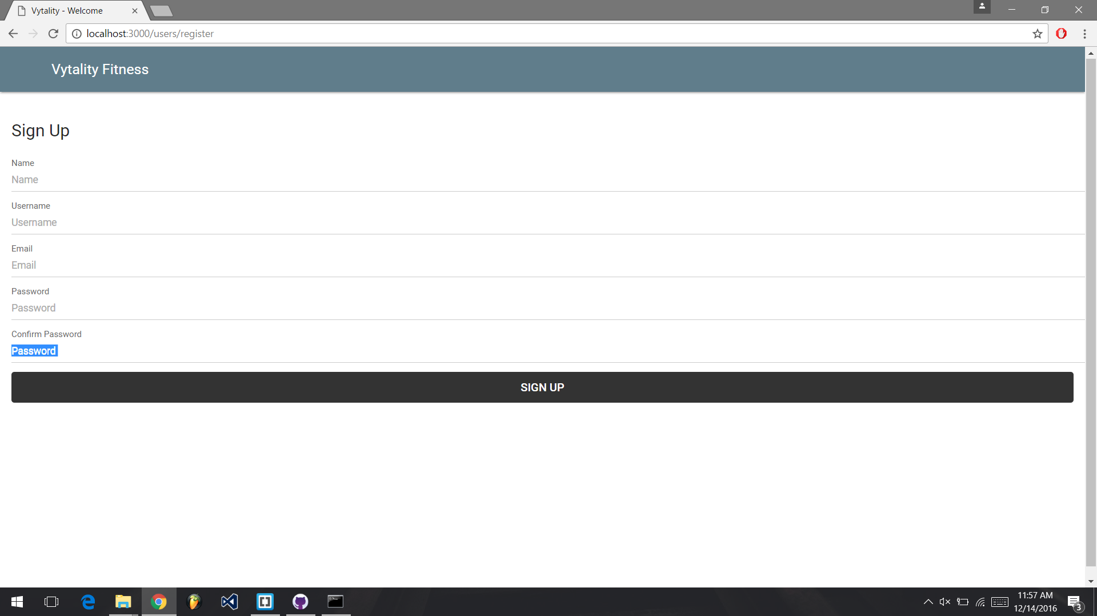
Sign up

Slide 6

Login

Slide 7

Exercises

Slide 8

Nutrition

Slide 9
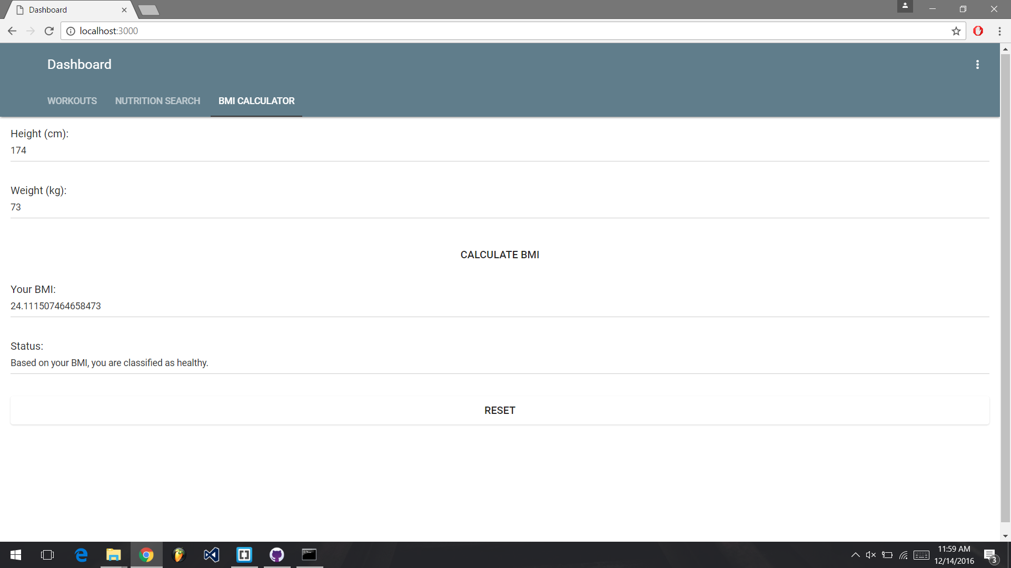
Calculating BMI

